Slide 1
KDD Cup Weekly Report
Team Nitre_plus
Zhongyu Jiang, Wenlong Gu, Weiran Yang

Slide 2
Update
Last Week
Feature: Time, Distance, Price, ETA
Model: SVM
F1 Score: 0.60
This Week
Feature: Time, Distance, Price, ETA, Order
Model: SVM, XGBoost

Slide 3
Result
Locally
F1 Score: 0.66
Precision: 0.65
Recall: 0.71
Leaderboard
F1 Score: 0.68
Rank: 524/698 (11 PM, May 17)

Slide 4
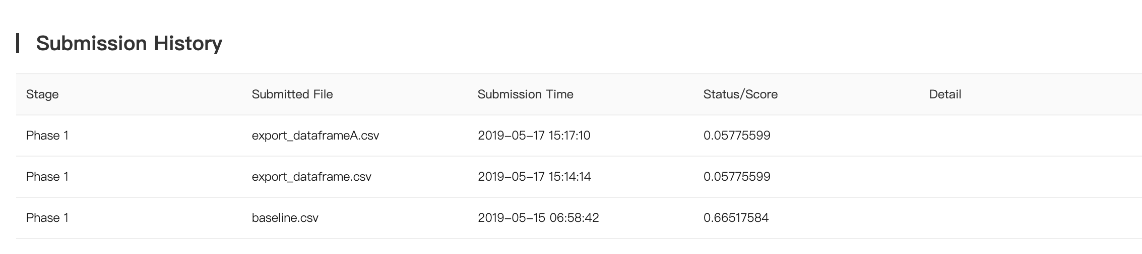
Submission
Zhongyu Jiang
Wenlong Gu
Weiran Yang

Slide 5
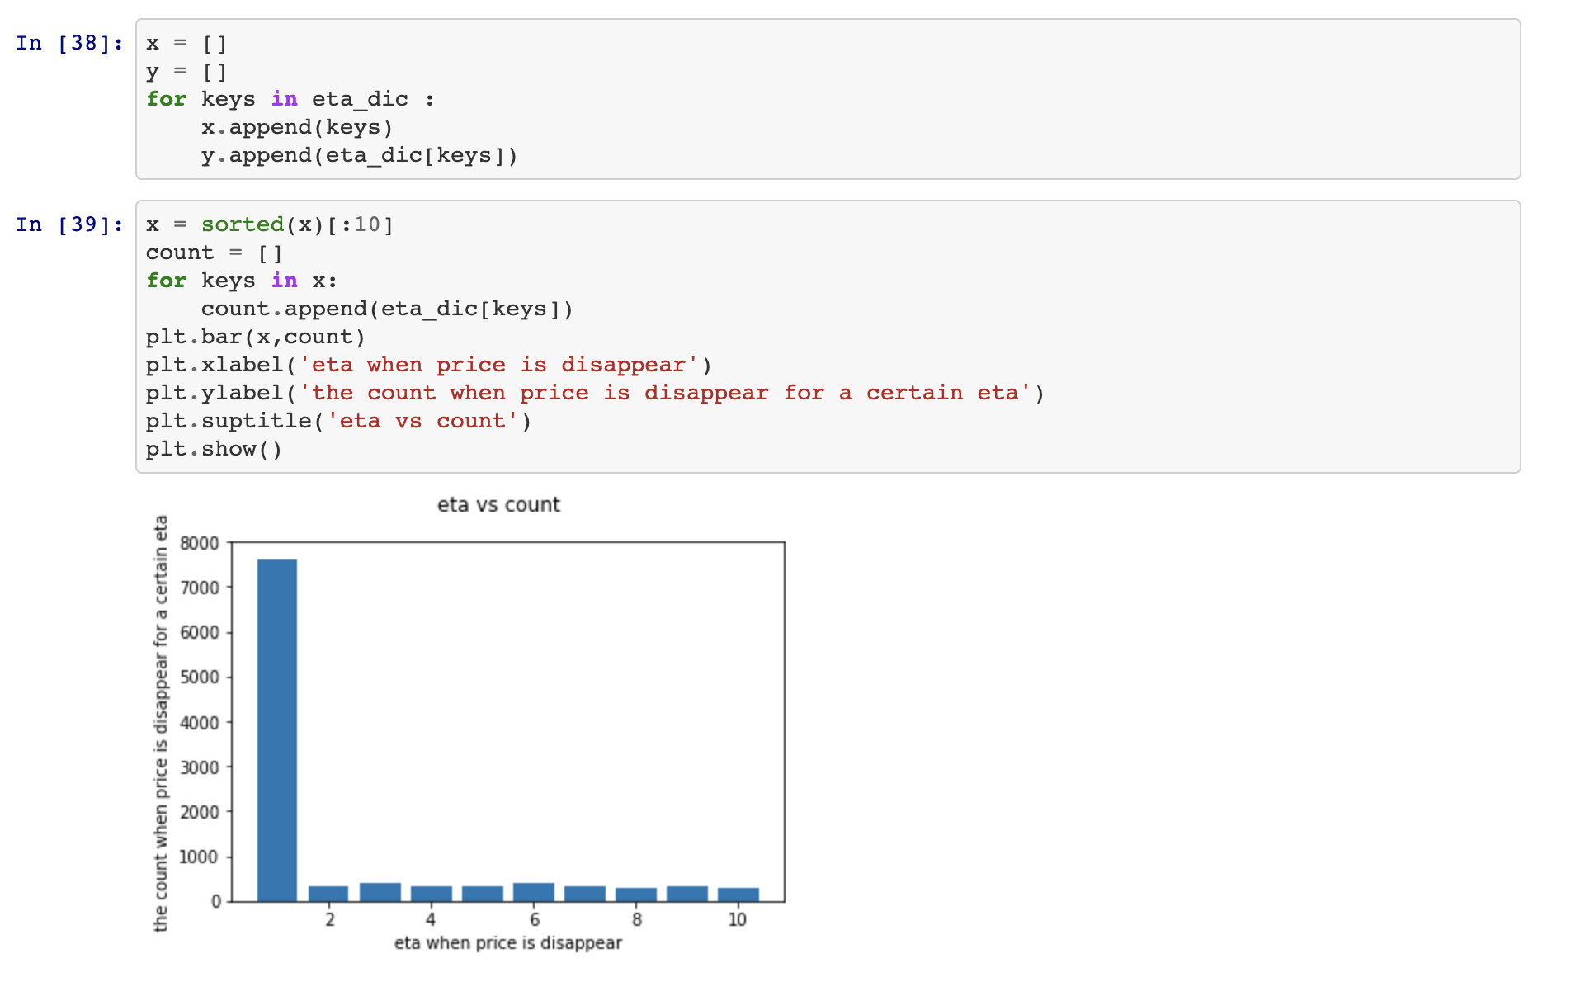
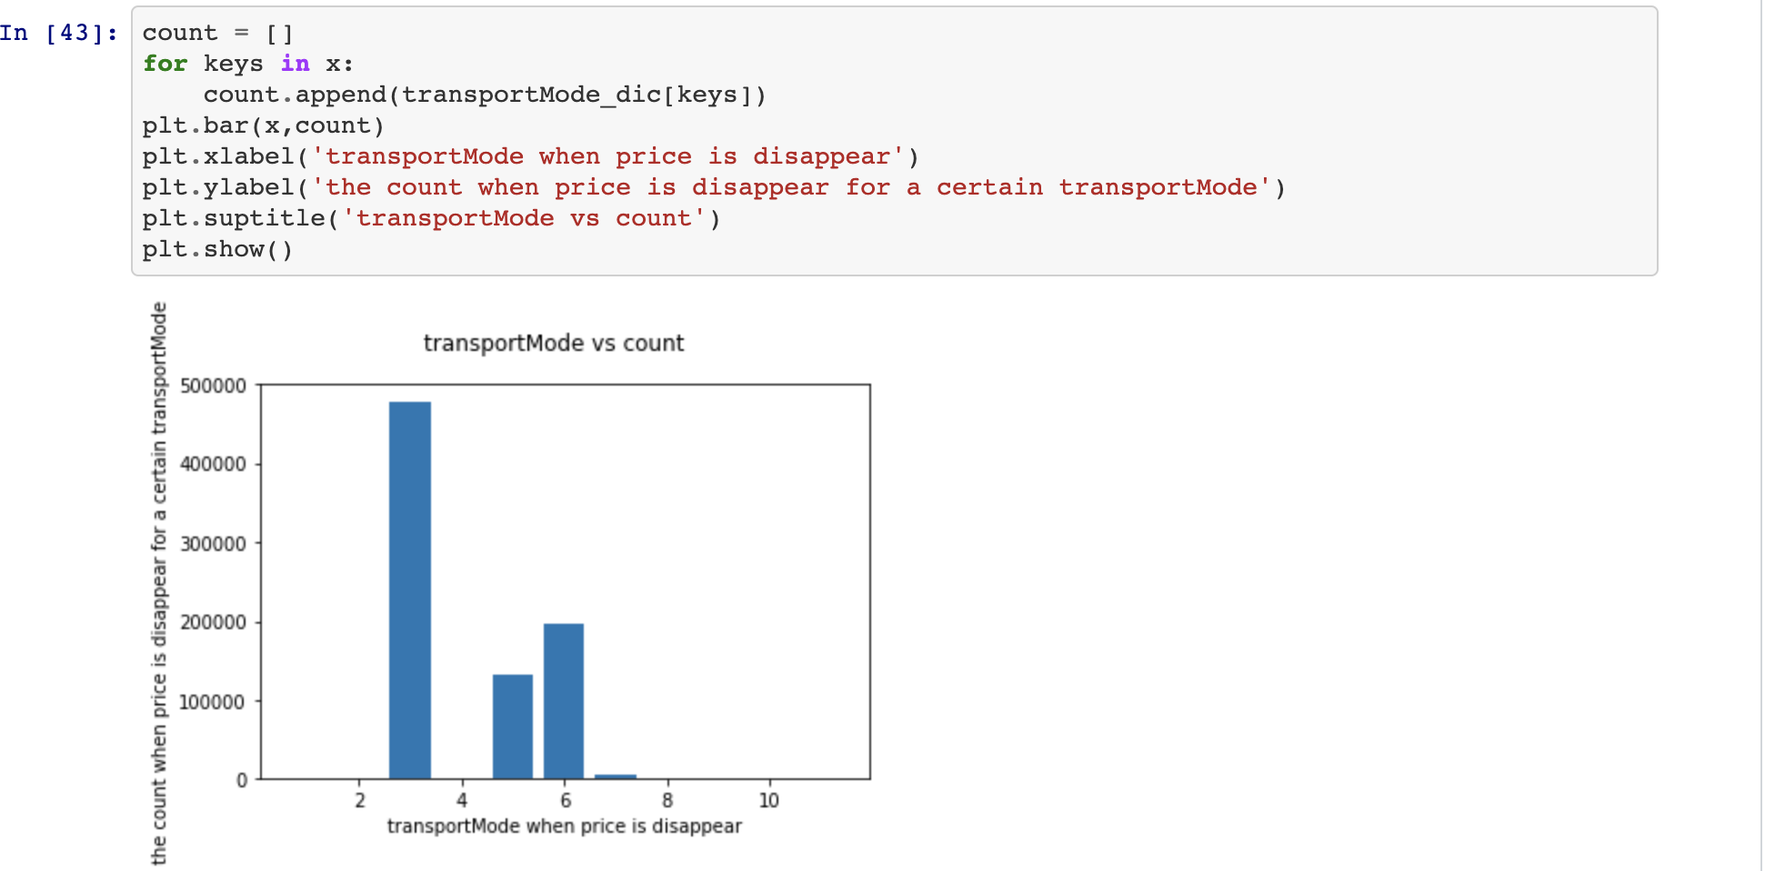
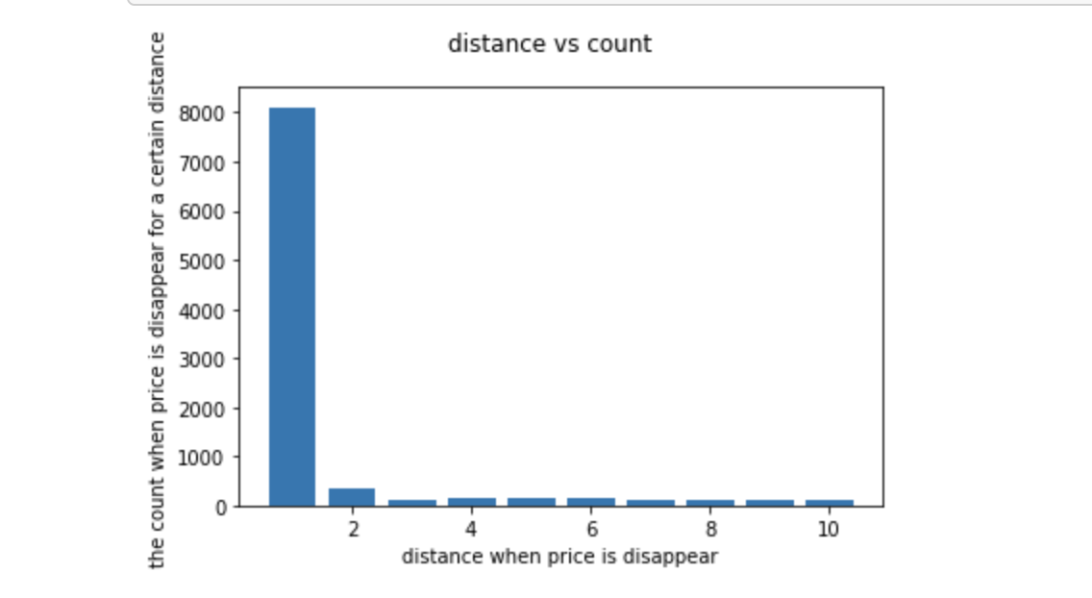
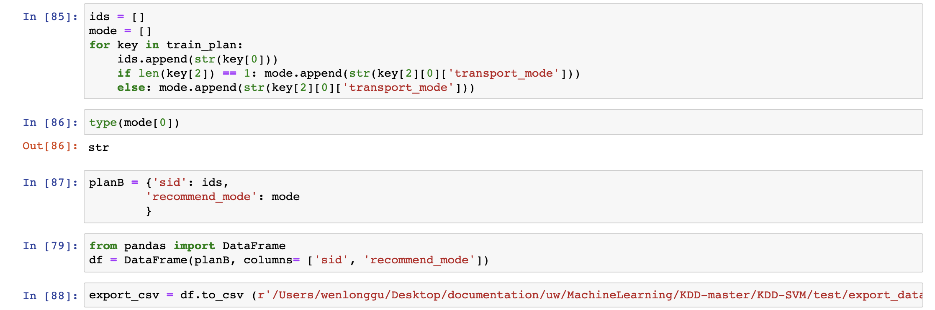
Wenlong’s Code

Slide 6
Next Week
Study features
Tune parameters and features to train models

